Slide 1
R-Workshop
Caroline Gahrmann, Yves Steiner
(& minor adjustments by Bernhard Piskernik)

Slide 2
Agenda
Introduction
Getting started
Data Wrangling
Descriptive Statistics
Inference Statistics
Resources & Best Practice

Slide 3
Why R?
Introduction
Getting Started
Data Wrangeling
Descriptive Statistics
Inference Statistics
Resources & Best Practices
R is Open Source → Free of charge
R is developed by researchers all over the world and constantly evolves
R has more statistical functions than any other software
R (or the R community) react to questions or error messages

Slide 4
Our Practice Data
Introduction
Getting started
Data Wrangeling
Descriptive Statistics
Inference Statistics
Resources & Best Practices
For the duration of the workshop, we are interested in exploring the following hypotheses:
H1: Employees who experience more illegitimate work tasks experience more strain anticipation.
Illegitimate Work Tasks
Strain Anticipation
+

Slide 5
Our Practice Data
Introduction
Getting started
Data Wrangeling
Descriptive Statistics
Inference Statistics
Resources & Best Practices
H2: The effect of illegitimate work task on strain anticipation is partially mediated by anger.
Anger
+
+
Illegitimate Work Tasks
Strain Anticipation
+

Slide 6
Our Practice Data
Introduction
Getting started
Data Wrangeling
Descriptive Statistics
Inference Statistics
Resources & Best Practices
H3: The effect of illegitimate work task on strain anticipation is attenuated by psychological safety.
Psychological Safety
-
Illegitimate Work Tasks
Strain Anticipation
+

Slide 7
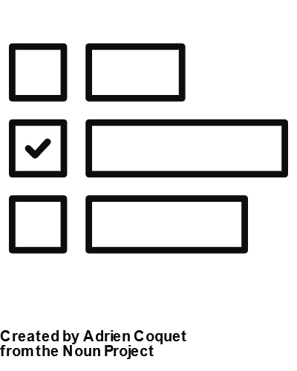

Our Practice Data
Introduction
Getting Started
Data Wrangeling
Descriptive Statistics
Inference Statistics
Resources & Best Practices
To explore these hypotheses, we have implemented the following study design:
…
BASELINE
t0
DAILY
t1
DAILY
t2
DAILY
t3-t9
DAILY
t10

Slide 8
Our Practice Data
Introduction
Getting Started
Data Wrangeling
Descriptive Statistics
Inference Statistics
Resources & Best Practices
We have recruited N = 94 employees to participate in the study.
To characterize the sample, we assessed the following information:
Variable | Question
ST_GENDER | What gender do you identify with the most?
 | 1 = female; 2 = male; 3 = not listed
ST_AGE | How old are you?

Slide 9
Our Practice Data
Introduction
Getting Started
Data Wrangeling
Descriptive Statistics
Inference Statistics
Resources & Best Practices
We have collected information about our study variables via these measures:
(1) Illegitimate Work Tasks (Semmer et al., 2010)
Variable | Item
- | Today, I had to take care of work tasks, which …
DA_ILWOTA_01_t1-10 | should have been done by someone else.
DA_ILWOTA_02_t1-10 | went too far and should not have been expected from me.
DA_ILWOTA_03_t1-10 | would not exist, if other people made less mistakes.
DA_ILWOTA_04_t1-10 | made no sense at all.
1 = not at all; 5 = completely

Slide 10
Our Practice Data
Introduction
Getting Started
Data Wrangeling
Descriptive Statistics
Inference Statistics
Resources & Best Practices
(2) Psychological Safety (Edmondson et al., 1999)
Variable | Item
- | Today, at work …
DA_PSYSAFE_01_t1-10 | it was possible to make mistakes without them being held against you.
DA_PSYSAFE_02_t1-10 | team members could address problems and sensitive issues without hesitation.
DA_PSYSAFE_03_t1-10 | it was possible, to take risks.
DA_PSYSAFE_04_t1-10 | it was easy to ask someone on the team for help.
DA_PSYSAFE_05_t1-10 | nobody would have intentionally undermined my efforts.
DA_PSYSAFE_06_t1-10 | my unique skills were appreciated and applied in the teams.
1 = not at all - 5 = completely; 6 = cannot answer because I was not involved in a team interaction

Slide 11
Our Practice Data
Introduction
Getting Started
Data Wrangeling
Descriptive Statistics
Inference Statistics
Resources & Best Practices
(3) Anger (Cranford et al., 2006)
Variable | Item
- | Today, I felt…
DA_MOOD_ANG_01_t1-10 | angry.
DA_MOOD_ANG_02_t1-10 | resentful.
DA_MOOD_ANG_03_t1-10 | annoyed.
1 = not at all; 5 = completely

Slide 12
Our Practice Data
Introduction
Getting Started
Data Wrangeling
Descriptive Statistics
Inference Statistics
Resources & Best Practices
(4) Strain Anticipation (Scott et al., 2015)
Variable | Item
DA_ANTC_01_t1-10 | How straining do you think your next workday will be?
DA_ANTC_02_r_t1-10 | How pleasant do you think your next working day will be?
1 = not at all; 100 = very

Slide 13
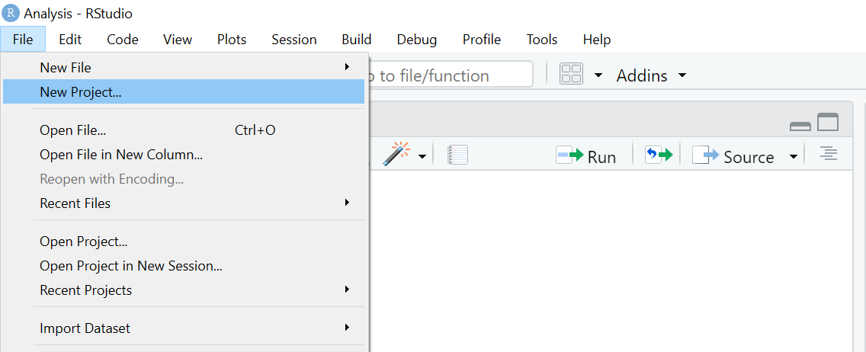
Creating a New Project
Introduction
Getting Started
Data Wrangeling
Descriptive Statistics
Inference Statistics
Resources & Best Practices
First things first: We have to create a new project for our data analysis. We should create a folder for this beforehand.
Step 1: Open RStudio.
Step 2: Select "File" on the upper toolbar.
Step 3: Select "New Project".

Slide 14
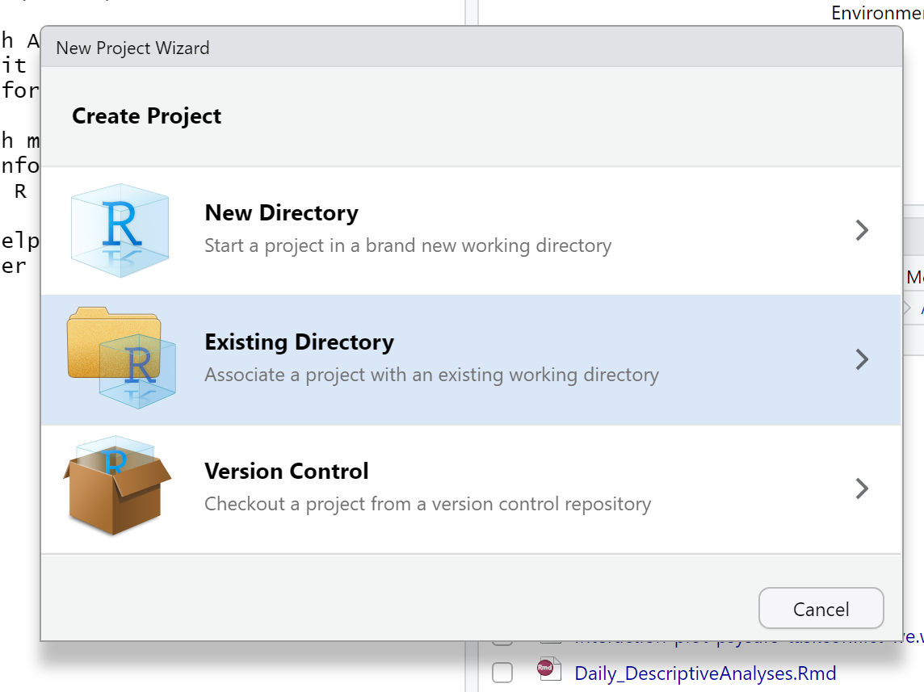
Creating a New Project
Introduction
Getting Started
Data Wrangeling
Descriptive Statistics
Inference Statistics
Resources & Best Practices
Step 4: Select "Existing Directory".

Slide 15
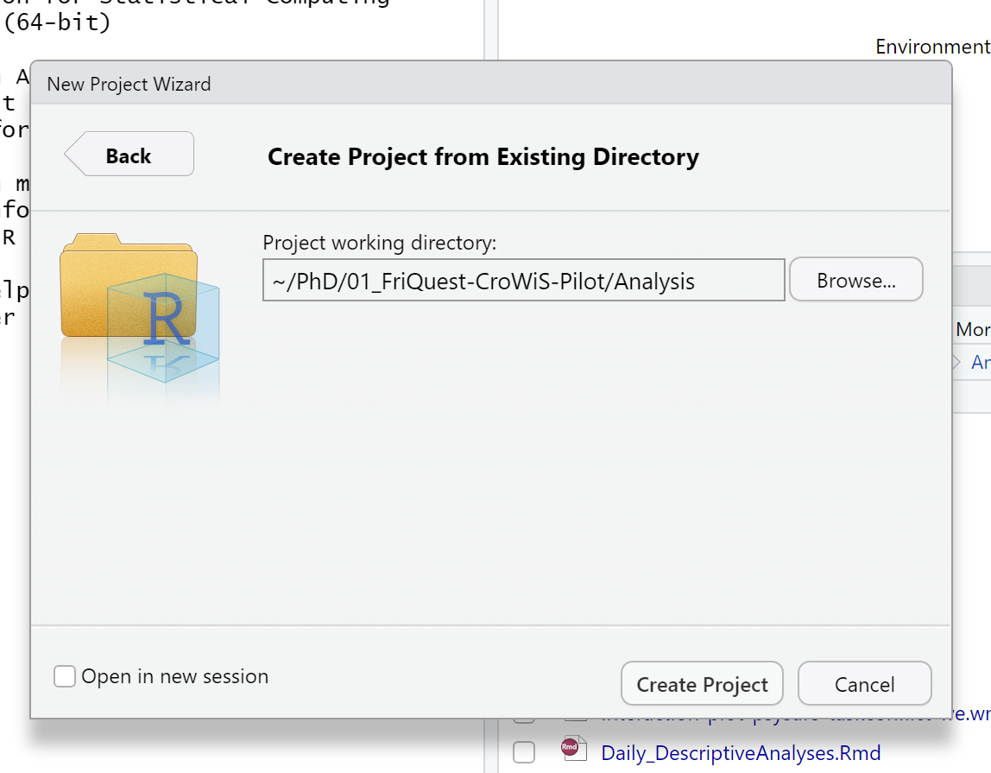
Creating a New Project
Introduction
Getting Started
Data Wrangeling
Descriptive Statistics
Inference Statistics
Resources & Best Practices
Step 5: Select "Browse".

Slide 16
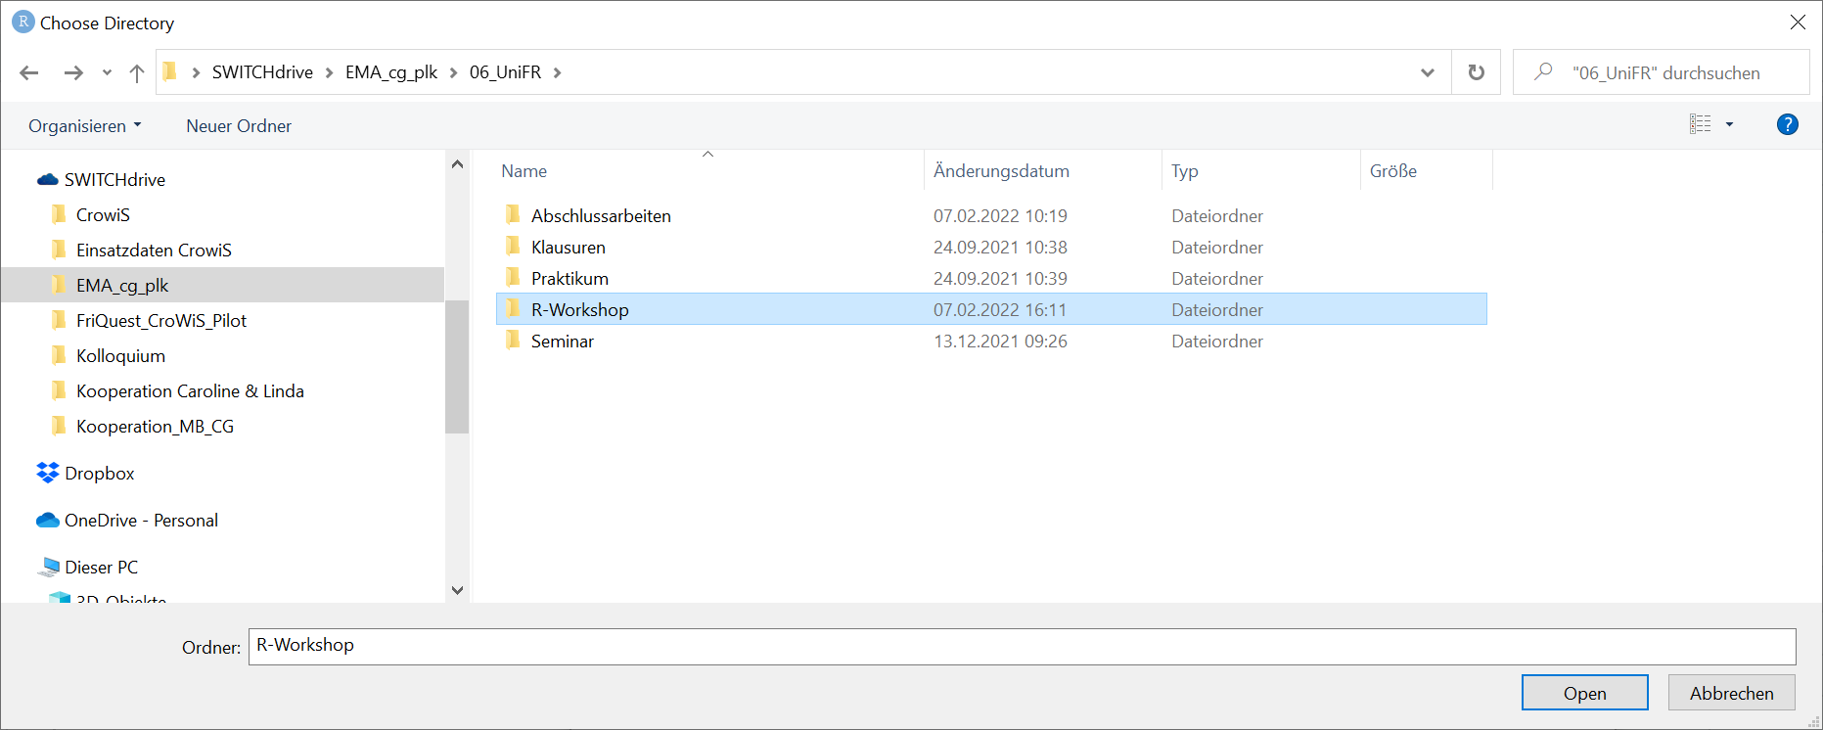
Creating a New Project
Introduction
Getting Started
Data Wrangeling
Descriptive Statistics
Inference Statistics
Resources & Best Practices
Step 6: Select folder of choice.
Step 7: Select "Open".

Slide 17
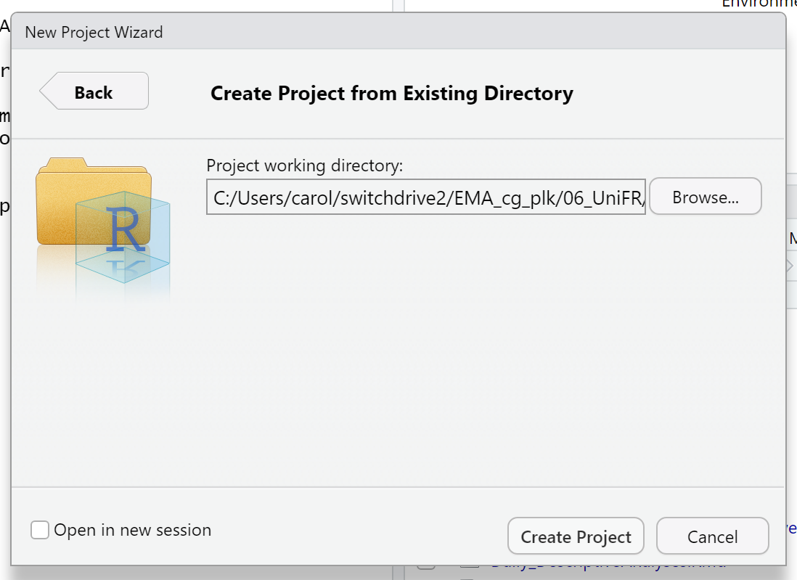
Creating a New Project
Introduction
Getting Started
Data Wrangeling
Descriptive Statistics
Inference Statistics
Resources & Best Practices
Step 8: Select "Create Project".

Slide 18
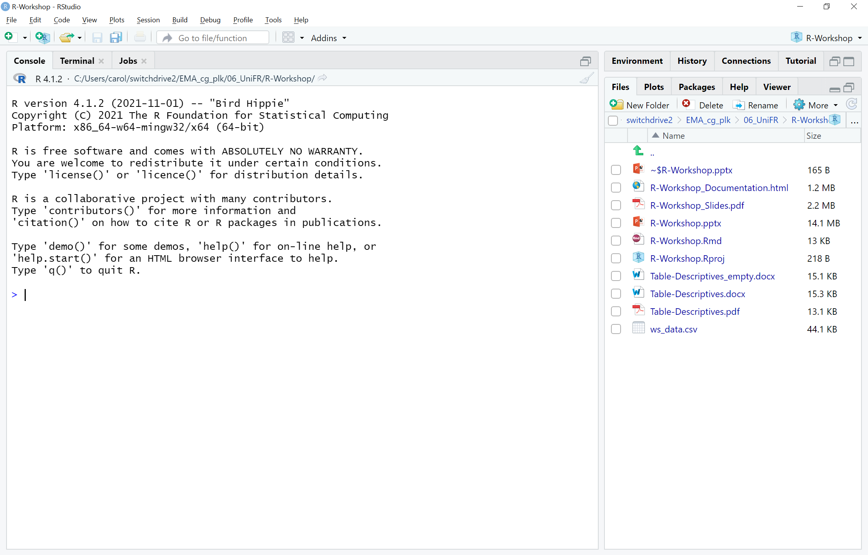
Creating a New Project
Introduction
Getting Started
Data Wrangeling
Descriptive Statistics
Inference Statistics
Resources & Best Practices
Hurray! We have now created a new project which functions as our working directory.

Slide 19
Introducing R Markdown
Introduction
Getting Started
Data Wrangeling
Descriptive Statistics
Inference Statistics
Resources & Best Practices
R Markdown can
… save and execute code
… generate static reports in different formats
You should use R Markdown to document and share your analysis with others.

Slide 20
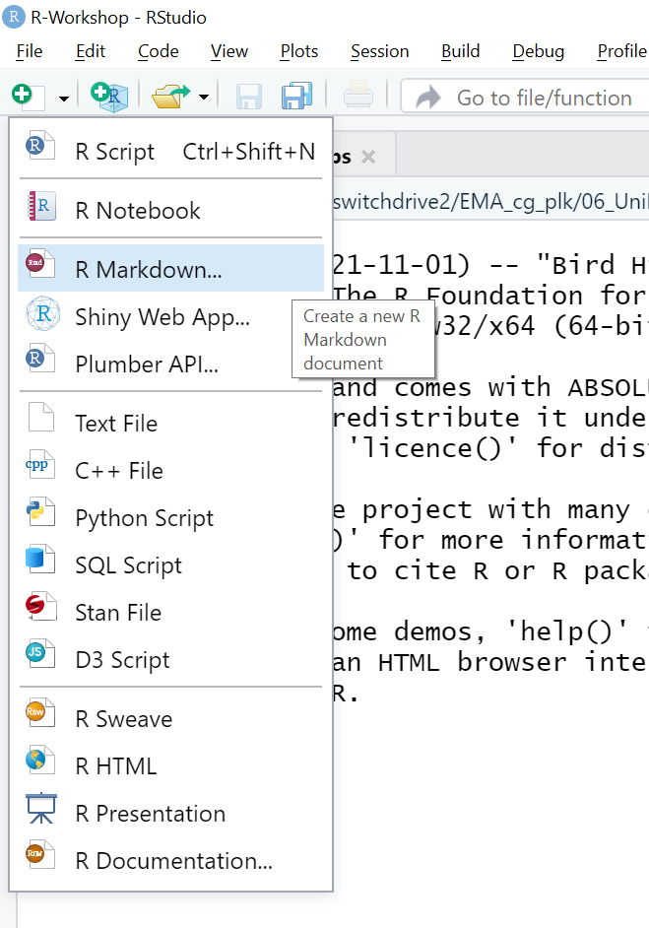
Creating an R Markdown
Introduction
Getting Started
Data Wrangeling
Descriptive Statistics
Inference Statistics
Resources & Best Practices
Step 1: Select the "New File" Icon on the second row of the toolbar.
Step 2: Select "R Markdown".

Slide 21
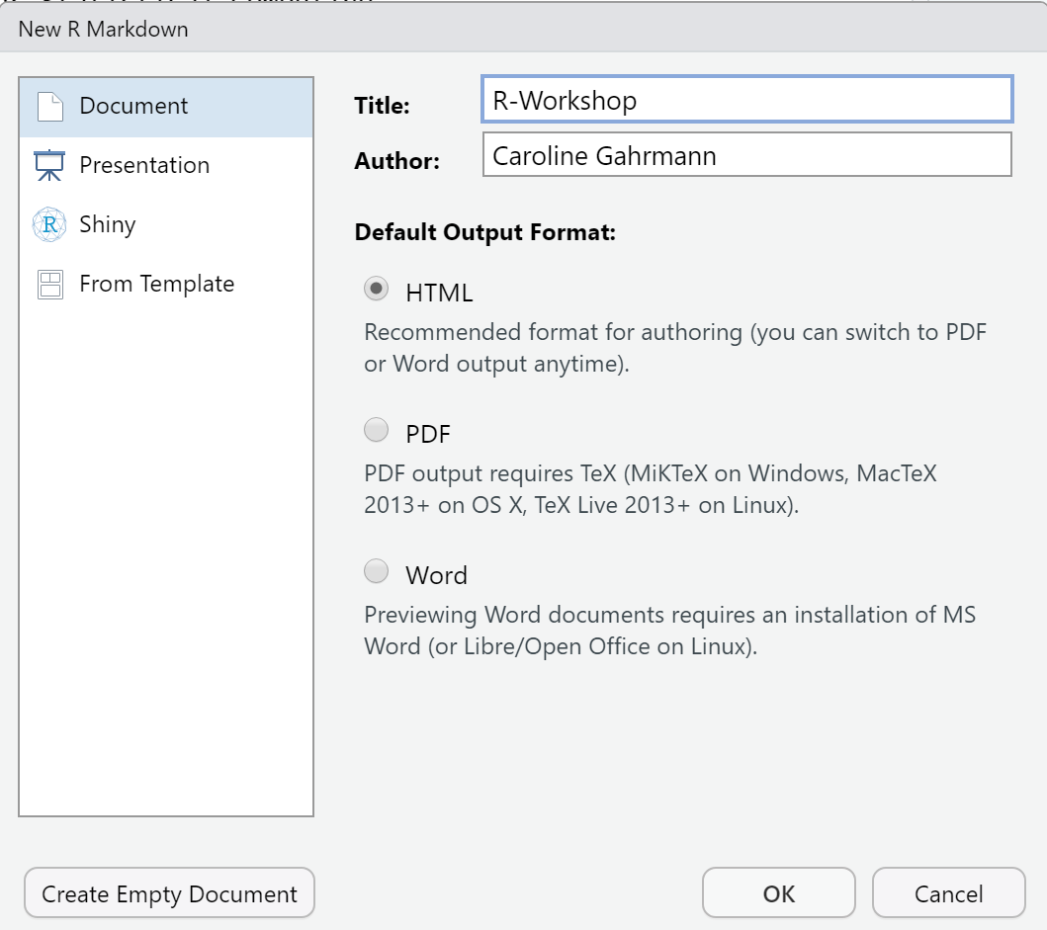
Creating an R Markdown
Introduction
Getting Started
Data Wrangeling
Descriptive Statistics
Inference Statistics
Resources & Best Practices
Step 3: Specify title of your R Markdown.
Step 4: Specifiy the author of your R Markdown.
Step 5: Specify which type of document you want to generate.
Step 6: Select 'OK'.

Slide 22
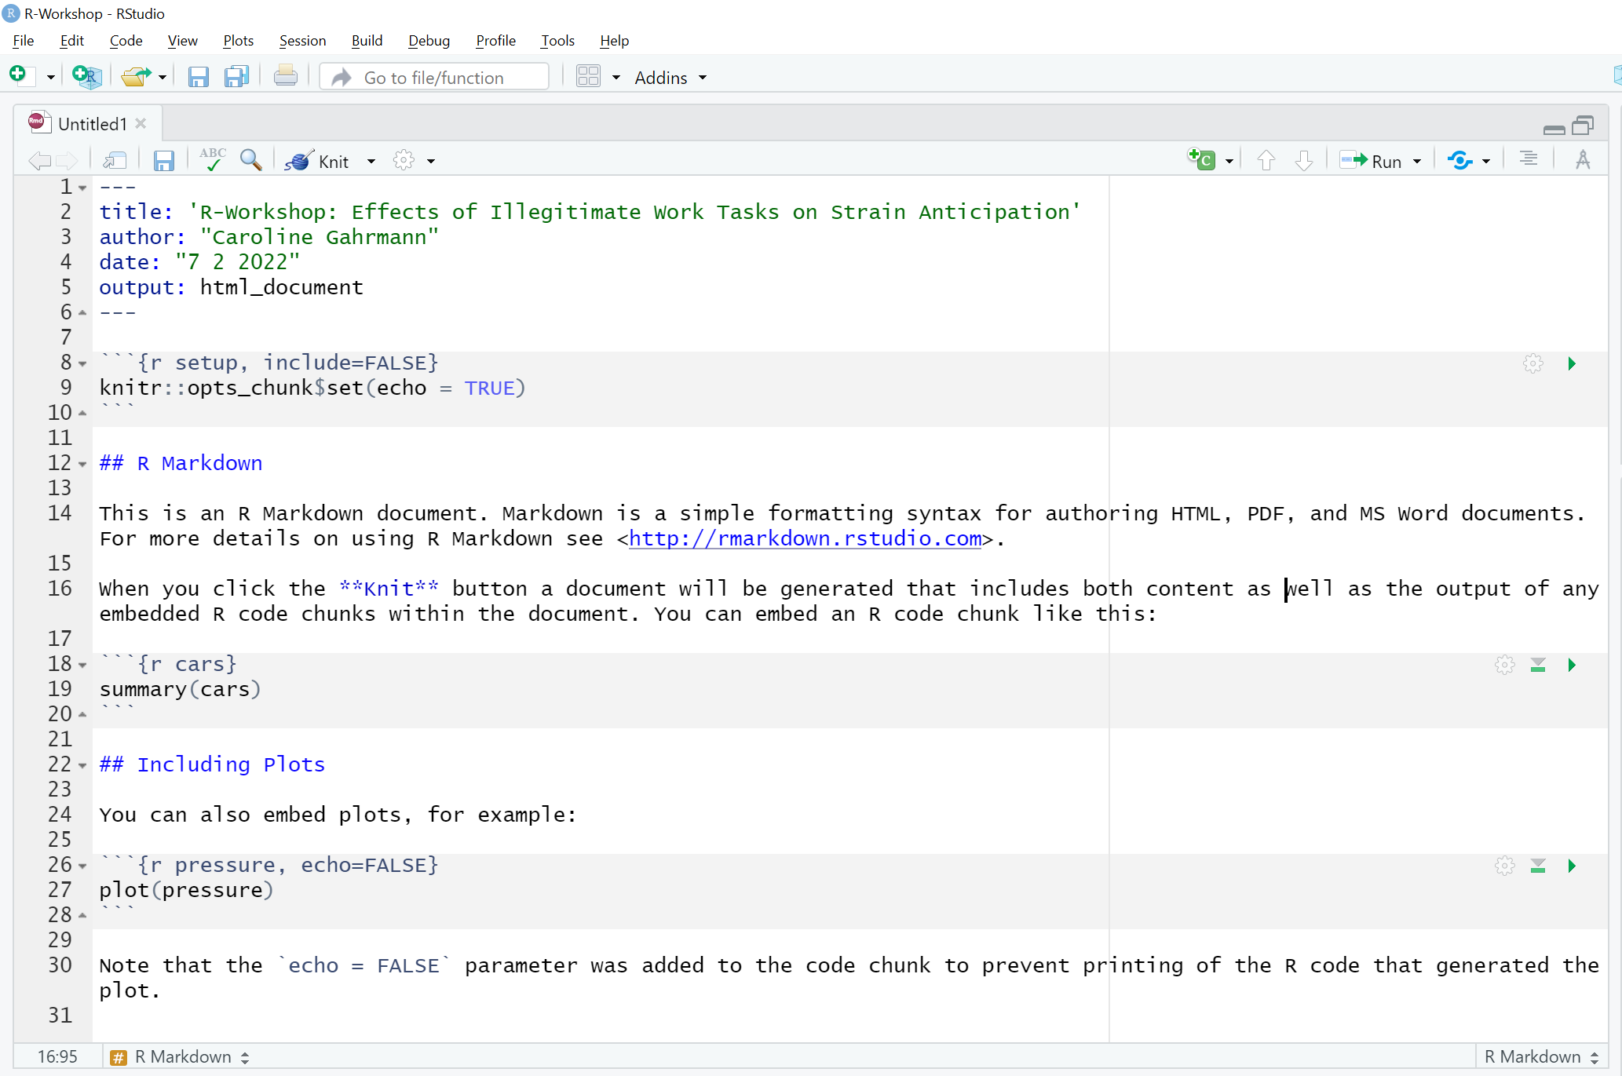
R Markdown explained
Introduction
Getting Started
Data Wrangeling
Descriptive Statistics
Inference Statistics
Resources & Best Practices
R Markdowns consist of three parts:
YAML metadata → guides generation of static documents
Notes:
R Markdowns consist of three parts "Code" "Report" and "Yaml" to compile.

Slide 23
R Markdown explained
Introduction
Getting Started
Data Wrangeling
Descriptive Statistics
Inference Statistics
Resources & Best Practices
Text → details statistical analysis
Notes:
R Markdowns consist of three parts "Code" "Report" and "Yaml" to compile.

Slide 24
R Markdown explained
Introduction
Getting Started
Data Wrangeling
Descriptive Statistics
Inference Statistics
Resources & Best Practices
Code → R functions
Notes:
R Markdowns consist of three parts "Code" "Report" and "Yaml" to compile.

Slide 25
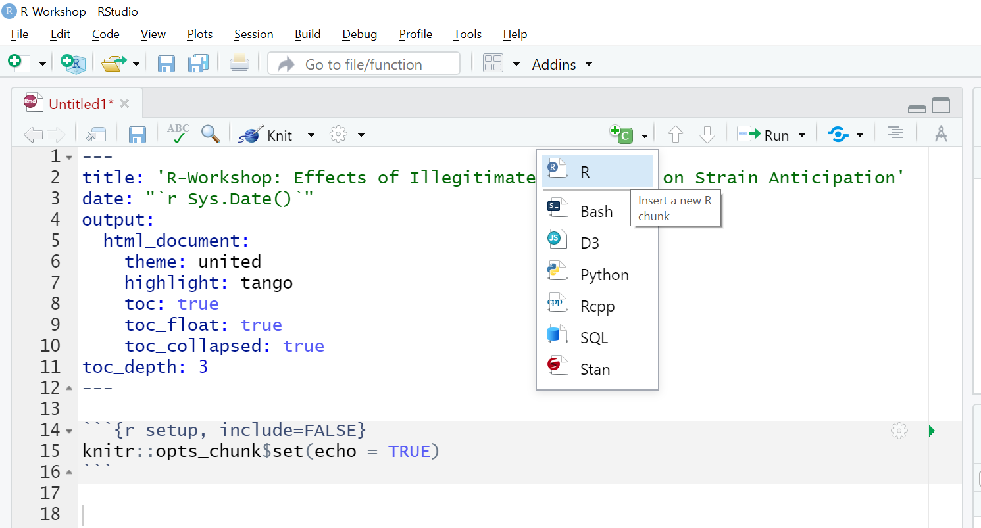
R Markdown How To
Introduction
Getting Started
Data Wrangeling
Descriptive Statistics
Inference Statistics
Resources & Best Practices
To insert new code chunks …
Step 1: Select the "Insert a new code chunk" Icon in the toolbar of the Editor.
Step 2: Select the "Insert a new R chunk" Icon.
Notes:
R Markdowns consist of three parts "Code" "Report" and "Yaml" to compile.

Slide 26
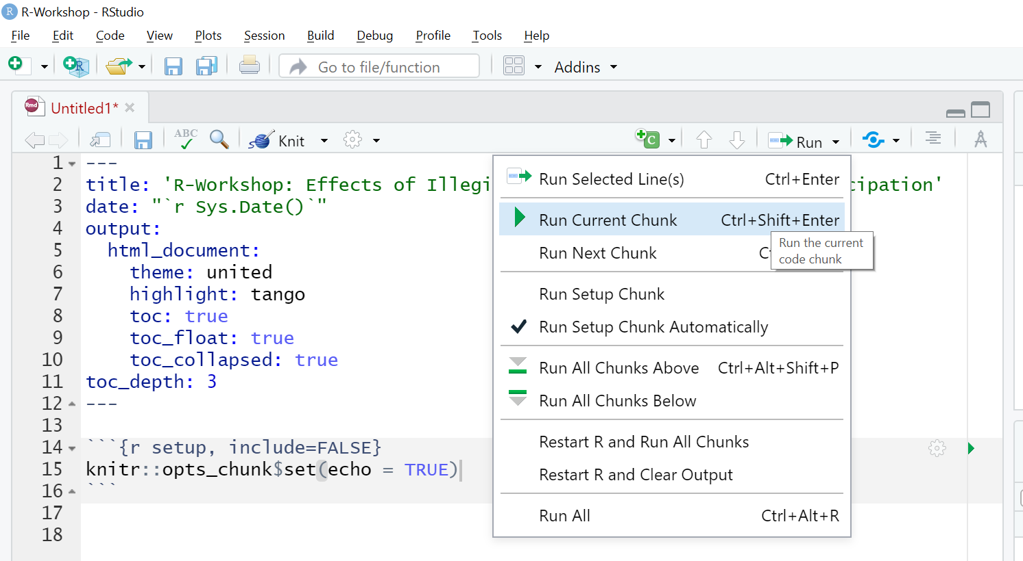
R Markdown How To
Introduction
Getting Started
Data Wrangeling
Descriptive Statistics
Inference Statistics
Resources & Best Practices
To run a code chunk …
Step 1: Click into the code chunk you want to run.
Step 2: Select the "Run" Icon in the toolbar of the Editor.
Step 3: Select "Run Current Chunk".
Alternative: Select the green triangle in the code chunk.
Notes:
R Markdowns consist of three parts "Code" "Report" and "Yaml" to compile.

Slide 27
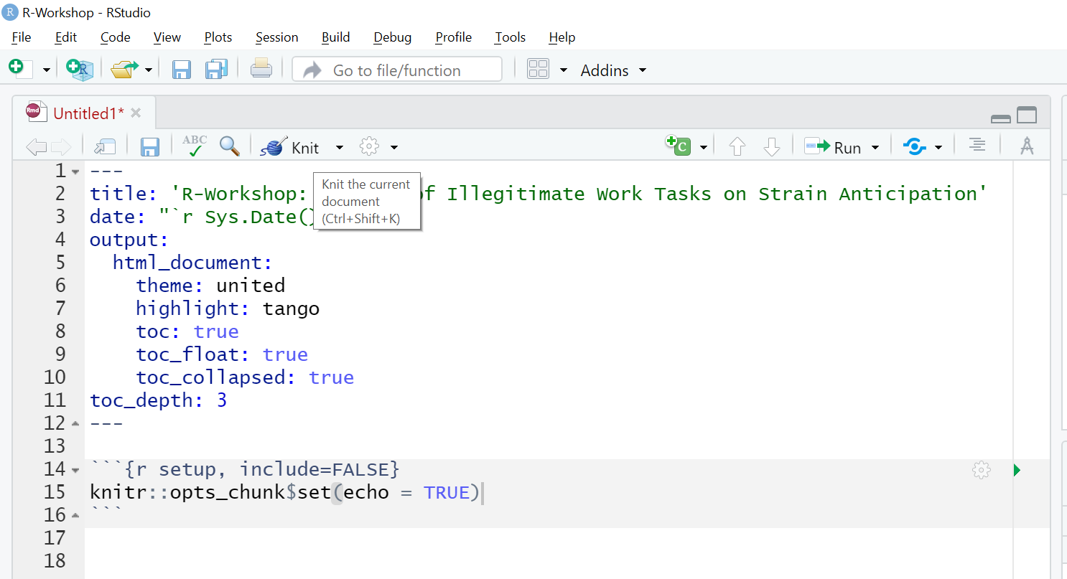
R Markdown How To
Introduction
Getting Started
Data Wrangeling
Descriptive Statistics
Inference Statistics
Resources & Best Practices
To generate a static report …
Step 1: Select the "Knit" Icon in the toolbar of the Editor.
Notes:
R Markdowns consist of three parts "Code" "Report" and "Yaml" to compile.

Slide 28
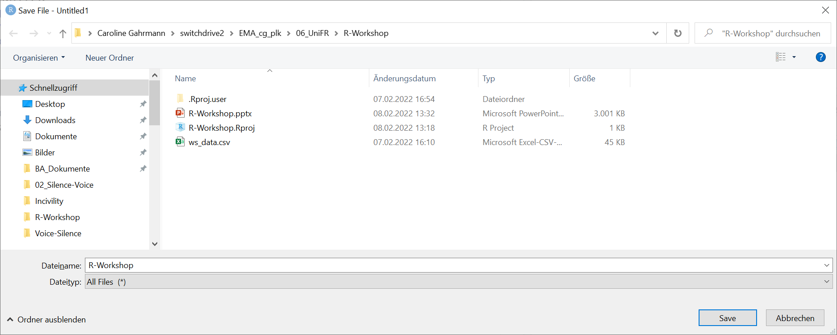
R Markdown How To
Introduction
Getting Started
Data Wrangeling
Descriptive Statistics
Inference Statistics
Resources & Best Practices
To generate static report …
Step 2: Type in document title.
Step 3: Select "Save".
You only have to do Step 2 and Step 3 once per R Markdown.
Notes:
R Markdowns consist of three parts "Code" "Report" and "Yaml" to compile.

Slide 29
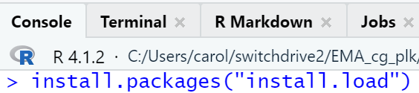
Prepare Packages
Introduction
Getting Started
Data Wrangeling
Descriptive Statistics
Inference Statistics
Resources & Best Practices
We want to first install all relevant packages.
In R, installing and loading packages are separate processes. We can join these procedures by installing the 'install.load' package:
Note that we only have to install the package once. We do this in the Console and not in the RMarkdown / R-script.
Notes:
R Markdowns consist of three parts "Code" "Report" and "Yaml" to compile.

Slide 30
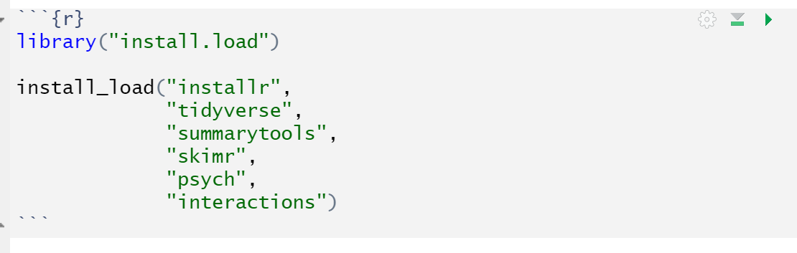
Prepare Packages
Introduction
Getting Started
Data Wrangeling
Descriptive Statistics
Inference Statistics
Resources & Best Practices
To install packages, if necessary, and load them we can now use library(install.load) and install_load():
library("install.load")
install_load("package1", "package2", "…")
Please load 'install.load' and prepare 'installr', 'tidyverse', 'summarytools', 'skimr', 'psych' and 'interactions' for the workshop.
Notes:
R Markdowns consist of three parts "Code" "Report" and "Yaml" to compile.

Slide 31
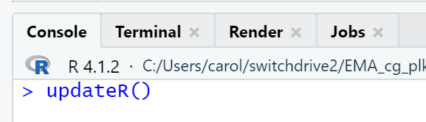
Check and Update R Version
Introduction
Getting Started
Data Wrangeling
Descriptive Statistics
Inference Statistics
Resources & Best Practices
To check if we have the newest R version installed, we can use updateR() in the Console:
updateR()
Please execute this code in the Console and do not save it in the RMarkdown. The RMarkdown won't be able to compile otherwise.
Notes:
R Markdowns consist of three parts "Code" "Report" and "Yaml" to compile.

Slide 32
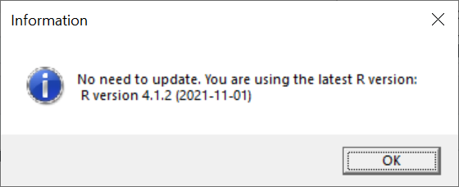
Check and Update R Version
Introduction
Getting Started
Data Wrangeling
Descriptive Statistics
Inference Statistics
Resources & Best Practices
If we have the newest R version already, we get the following message.
We only have to select 'OK' an move on.
Notes:
R Markdowns consist of three parts "Code" "Report" and "Yaml" to compile.

Slide 33
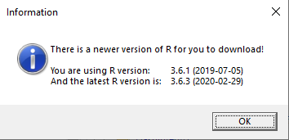
Check and Update R Version
Introduction
Getting Started
Data Wrangeling
Descriptive Statistics
Inference Statistics
Resources & Best Practices
If we don't have the newest R version, we get the following message:
We can now download the newest version:
Step 1: Select 'OK'.
Notes:
R Markdowns consist of three parts "Code" "Report" and "Yaml" to compile.

Slide 34
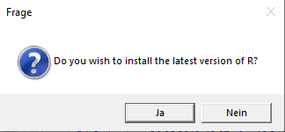
Check and Update R Version
Introduction
Getting Started
Data Wrangeling
Descriptive Statistics
Inference Statistics
Resources & Best Practices
Step 2: Select 'Yes'.
Notes:
R Markdowns consist of three parts "Code" "Report" and "Yaml" to compile.

Slide 35
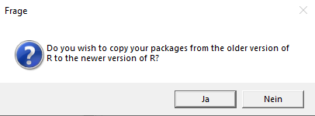
Check and Update R Version
Introduction
Getting Started
Data Wrangeling
Descriptive Statistics
Inference Statistics
Resources & Best Practices
Hurray! We get to keep our packages!
Step 3: Select 'Yes': You want to keep all your packages in place.
Notes:
R Markdowns consist of three parts "Code" "Report" and "Yaml" to compile.

Slide 36
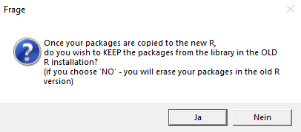
Check and Update R Version
Introduction
Getting Started
Data Wrangeling
Descriptive Statistics
Inference Statistics
Resources & Best Practices
Step 4: Select 'No': You don't want to use the old version of R and therefore don't need the packages for that version any longer.
Notes:
R Markdowns consist of three parts "Code" "Report" and "Yaml" to compile.

Slide 37
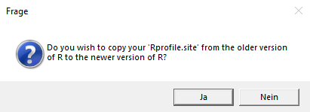
Check and Update R Version
Introduction
Getting Started
Data Wrangeling
Descriptive Statistics
Inference Statistics
Resources & Best Practices
Step 5: Select 'Yes'.
Notes:
R Markdowns consist of three parts "Code" "Report" and "Yaml" to compile.

Slide 38
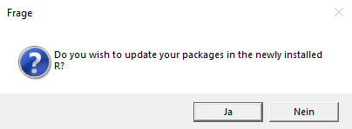
Check and Update R Version
Introduction
Getting Started
Data Wrangeling
Descriptive Statistics
Inference Statistics
Resources & Best Practices
We even have the chance to update all our packages!
Step 6: Select 'Yes'.
Notes:
R Markdowns consist of three parts "Code" "Report" and "Yaml" to compile.

Slide 39
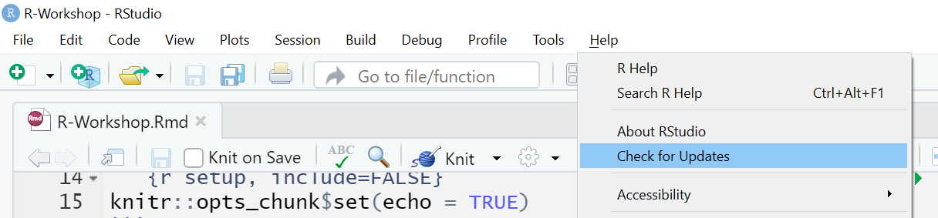
RStudio Updates
Introduction
Getting Started
Data Wrangeling
Descriptive Statistics
Inference Statistics
Resources & Best Practices
We can also check if we have the newest version of RStudio:
Step 1: Select 'Help' on the upper toolbar.
Step 2: Select 'Check for Updates'.
If a new version is available, the RStudio page opens in the browser.
We can install it there.
Notes:
R Markdowns consist of three parts "Code" "Report" and "Yaml" to compile.

Slide 40
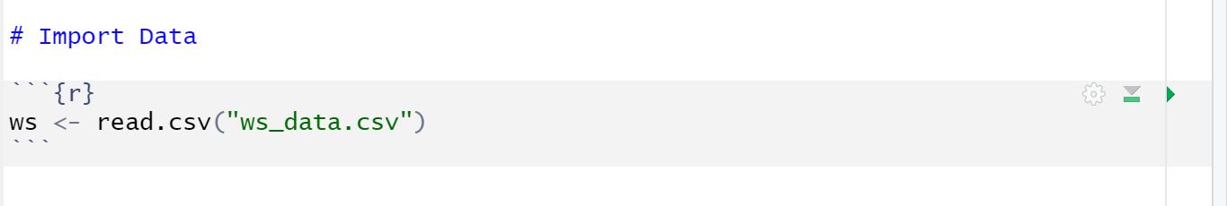
Import Data
Introduction
Getting Started
Data Wrangeling
Descriptive Statistics
Inference Statistics
Resources & Best Practices
Our practice data is a .csv file. To import it, we can use read.csv():
Step 1: internal-name-for-dataset <- read.csv("dataset.csv")
Step 2: run code chunk.
You can also import data in other formats using the "read" function. You find more information here: https://intro2r.com/importing-data.html
Notes:
R Markdowns consist of three parts "Code" "Report" and "Yaml" to compile.

Slide 41
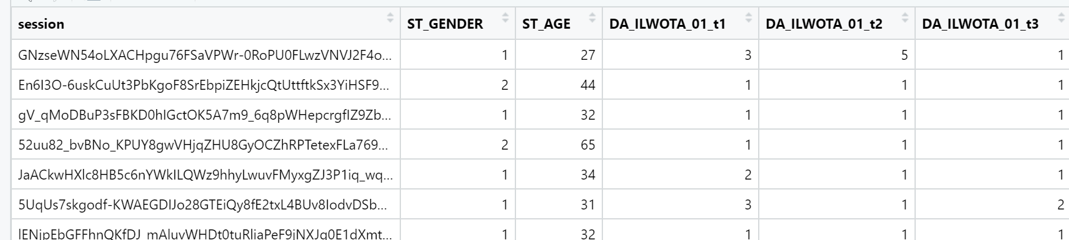
What now?
Introduction
Getting Started
Data Wrangeling
Descriptive Statistics
Inference Statistics
Resources & Best Practices
We have imported our data. It looks like this:
In the end, we want to probe our hypotheses via regression analyses.
What do have to do to get there?
Notes:
R Markdowns consist of three parts "Code" "Report" and "Yaml" to compile.

Slide 42
Rescale Items
Introduction
Getting Started
Data Wrangeling
Descriptive Statistics
Inference Statistics
Resources & Best Practices
We have inverted items in our data:
We have to reverse 'DA_ANTC_02_r_t1' – 'DA _ANTC_02_r_t10' so it reflects employee strain anticipation.
Variable | Item
DA_ANTC_01_t1-10 | How straining do you think your next workday will be?
DA_ANTC_02_r_t1-10 | How pleasant do you think your next working day will be?
1 = not at all; 100 = very
Notes:
R Markdowns consist of three parts "Code" "Report" and "Yaml" to compile.

Slide 43
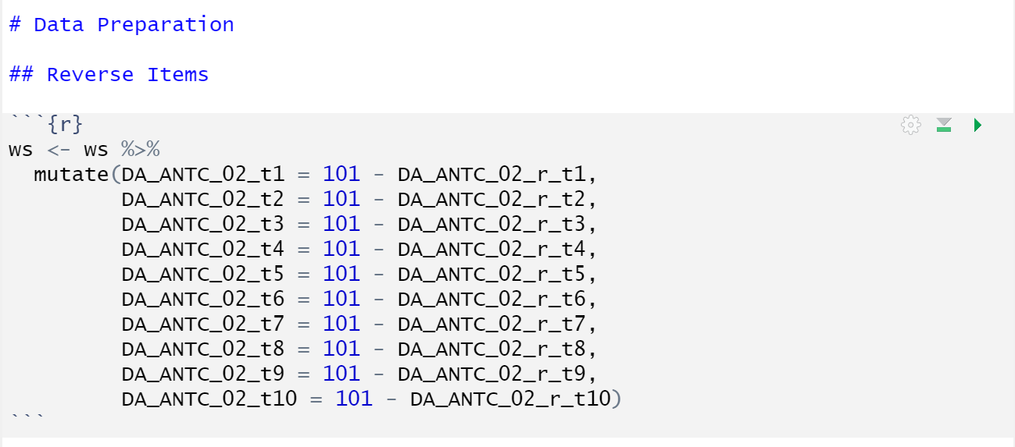
Rescale Items
Introduction
Getting Started
Data Wrangeling
Descriptive Statistics
Inference Statistics
Resources & Best Practices
To revese items, we can use mutate ():
internal-name-for-dataset <- internal-name-for-dataset %>%
mutate(variable_new = scale-max-plus-scale-min – variable_old)
The function is sensitive to the maximum and minimum of the scale.
Notes:
R Markdowns consist of three parts "Code" "Report" and "Yaml" to compile.

Slide 44
Code NAs
Introduction
Getting Started
Data Wrangeling
Descriptive Statistics
Inference Statistics
Resources & Best Practices
We have values that should be NAs in our data:
We have to ensure that '6' is replaced by 'NA' for all items measuring Psychological Safety.
DA_PSYSAFE_06_t1-10 | my unique skills were appreciated and applied in the teams.
1 = not at all - 5 = completely; 6 = cannot answer because I was not involved in a team interaction
Notes:
R Markdowns consist of three parts "Code" "Report" and "Yaml" to compile.

Slide 45
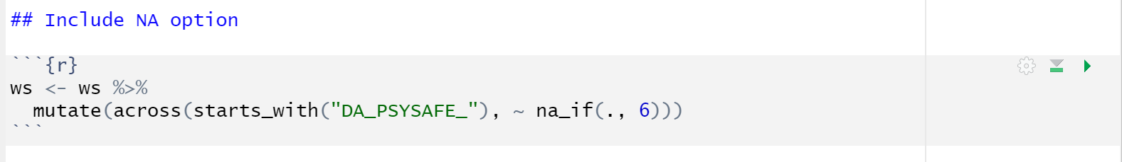
Code NAs
Introduction
Getting Started
Data Wrangeling
Descriptive Statistics
Inference Statistics
Resources & Best Practices
To convert values to NA, we can use na_if():
internal-name-for-dataset <- internal-name-for-dataset %>%
mutate(across(starts_with("shared-beginning-of-itemnames"), ~ na_if(., scale-value-should-be-NA)
Instead of 'starts_with', you may sometimes want to use other specifiers.
If you want to convert a given value (e.g., "-99") to NA …
… across all numeric variables in the dataset → where(is.numeric)
… for specific variables → c()
Notes:
R Markdowns consist of three parts "Code" "Report" and "Yaml" to compile.

Slide 46
Aggregate Data
Introduction
Getting Started
Data Wrangeling
Descriptive Statistics
Inference Statistics
Resources & Best Practices
Each of our study variables is currently measured by multiple items at multiple times.
But, to estimate our regression model we have to comprise all of this data into one score.
How do we go about this?
Notes:
R Markdowns consist of three parts "Code" "Report" and "Yaml" to compile.

Slide 47
Aggregate Data
Introduction
Getting Started
Data Wrangeling
Descriptive Statistics
Inference Statistics
Resources & Best Practices
All this data …
Step 1: Aggregate mean score
within occasion
Step 2: Aggregate mean score
over occasions
Voilà!
DA_ANTC_01_t1 | DA_ANTC_02_t1 | DA_ANTC_01_t2 | DA_ANTC_02_t2
2 | 1 | 4 | 5
DA_ANTC_t1 | DA_ANTC_t2
1.5 | 4.5
DA_ANTC
3
Notes:
R Markdowns consist of three parts "Code" "Report" and "Yaml" to compile.

Slide 48
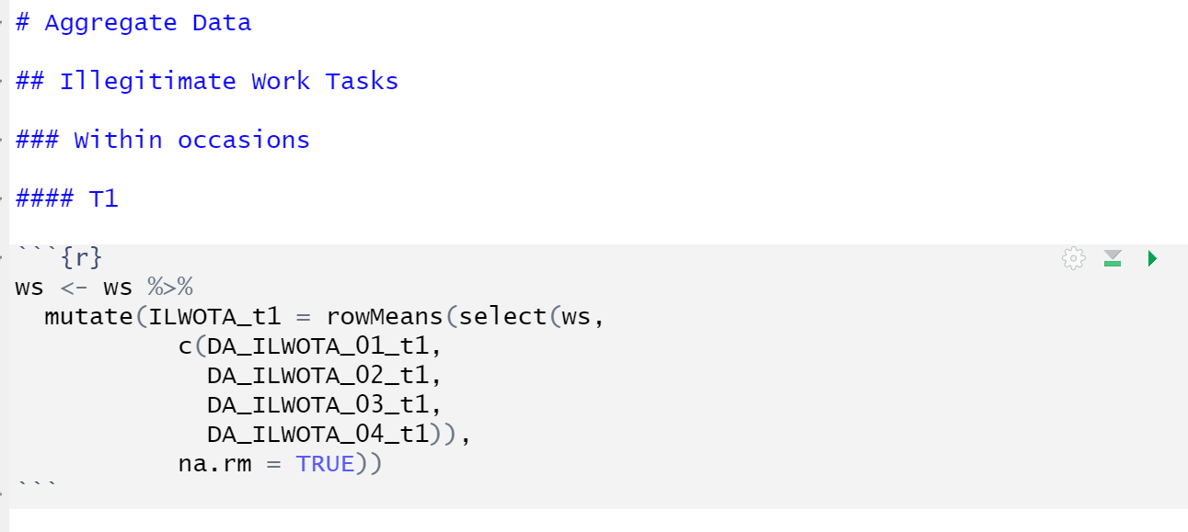
Aggregate Data
Introduction
Getting Started
Data Wrangeling
Descriptive Statistics
Inference Statistics
Resources & Best Practices
To aggregate data, we can use rowMeans():
internal-name-for-dataset <- internal-name-for-dataset %>% mutate(scale-name-aggregated =
rowMeans(select(internal-name-for-dataset,
c(scale-item-1,
scale-item-X)), na.rm = TRUE))
Notes:
R Markdowns consist of three parts "Code" "Report" and "Yaml" to compile.

Slide 49
Aggregate Data
Introduction
Getting Started
Data Wrangeling
Descriptive Statistics
Inference Statistics
Resources & Best Practices
You can do it!
Aggregate the occasion specific mean scores for "Illegitimate Work Tasks".
Now let's try something a bit trickier: Aggregate the occasion specific mean scores into a scale specific mean score for "Illegitimate Work Task".
Notes:
R Markdowns consist of three parts "Code" "Report" and "Yaml" to compile.

Slide 50
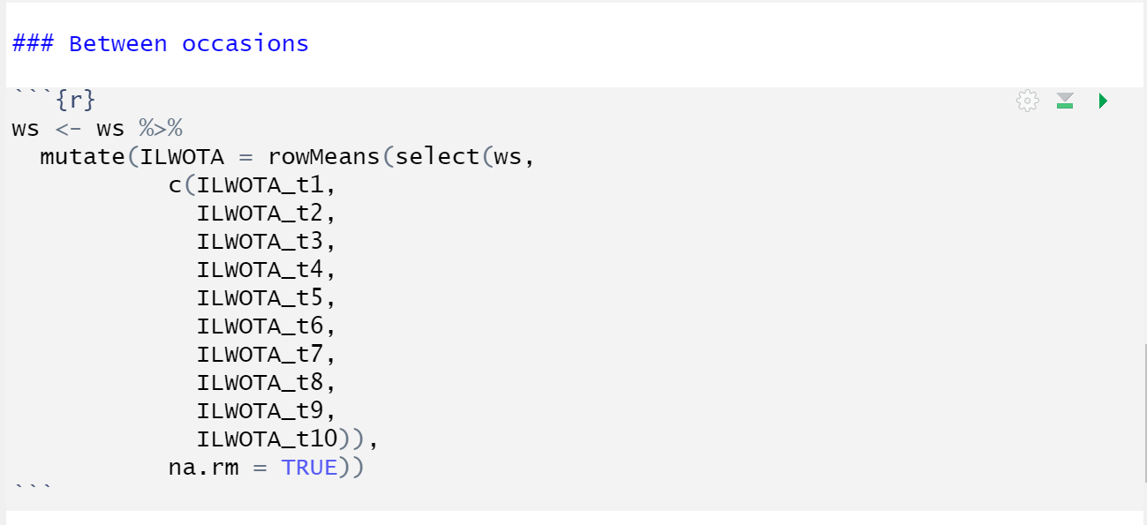
Aggregate Data
Introduction
Getting Started
Data Wrangeling
Descriptive Statistics
Inference Statistics
Resources & Best Practices
Aggregating the occasion specific mean scores into a scale specific mean score.
Notes:
R Markdowns consist of three parts "Code" "Report" and "Yaml" to compile.

Slide 51
Aggregate Data
Introduction
Getting Started
Data Wrangeling
Descriptive Statistics
Inference Statistics
Resources & Best Practices
OK, OK – aggregating becomes repetitive.
You have now learned how to do it and can hopefully apply it to your own thesis.
For the workshop you can simply copy and paste the code from the documentation on Moodle.
Notes:
R Markdowns consist of three parts "Code" "Report" and "Yaml" to compile.

Slide 52
Characterizing the sample
Introduction
Getting Started
Data Wrangeling
Descriptive Statistics
Inference Statistics
Resources & Best Practices
We have information on gender and age of participants to characterize the sample.
What can we do with this?
Gender → determine relative proportion of the sample per gender affiliation
Age → mean age and standard deviation
Notes:
R Markdowns consist of three parts "Code" "Report" and "Yaml" to compile.

Slide 53
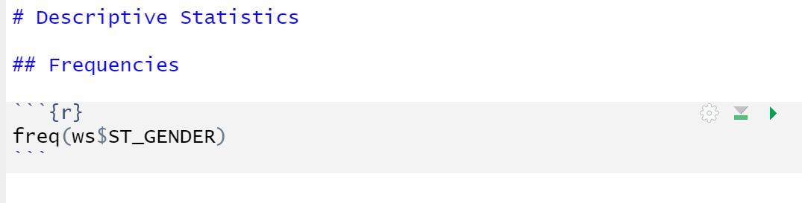
Characterizing the sample
Introduction
Getting Started
Data Wrangeling
Descriptive Statistics
Inference Statistics
Resources & Best Practices
To examine proportions, we can use freq():
freq(internal-name-for-dataset$variable-of-interest)
Please note that we use the freq funtion from the 'summarytools' package.
Notes:
R Markdowns consist of three parts "Code" "Report" and "Yaml" to compile.

Slide 54
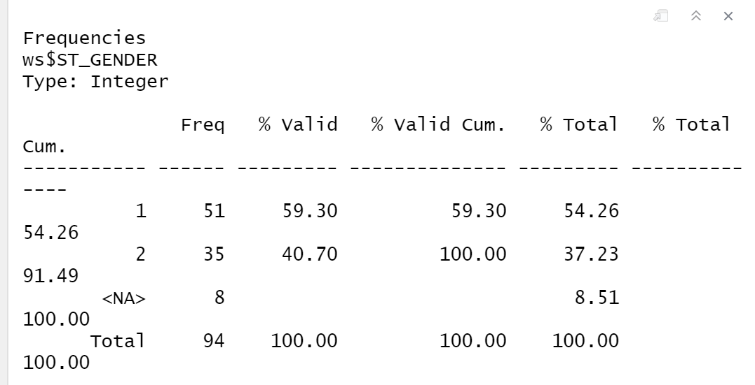
Characterizing the sample
Introduction
Getting Started
Data Wrangeling
Descriptive Statistics
Inference Statistics
Resources & Best Practices
How we interpret the output:
54.26 % of the sample identifies as female.
37.23 % of the sample identifies as male.
8.51 % of the sample did not respond.
Notes:
R Markdowns consist of three parts "Code" "Report" and "Yaml" to compile.

Slide 55
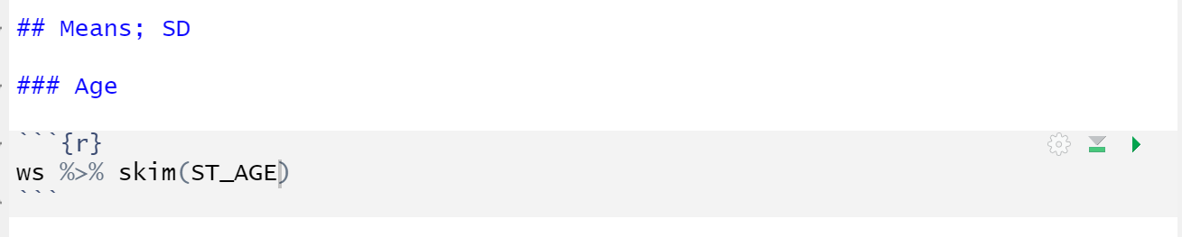
Characterizing the sample
Introduction
Getting Started
Data Wrangeling
Descriptive Statistics
Inference Statistics
Resources & Best Practices
To examine means and standard deviations, we can use skim():
internal-name-for-dataset %>% skim(variable-of-interest)
Notes:
R Markdowns consist of three parts "Code" "Report" and "Yaml" to compile.

Slide 56
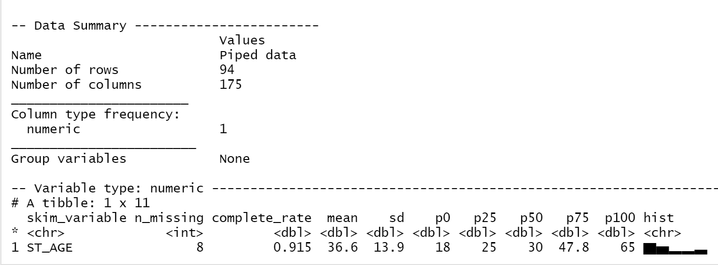
Characterizing the sample
Introduction
Getting Started
Data Wrangeling
Descriptive Statistics
Inference Statistics
Resources & Best Practices
How we interpret the output:
The average age of participants is 36.6 years (SD = 13.9).
Notes:
R Markdowns consist of three parts "Code" "Report" and "Yaml" to compile.

Slide 57
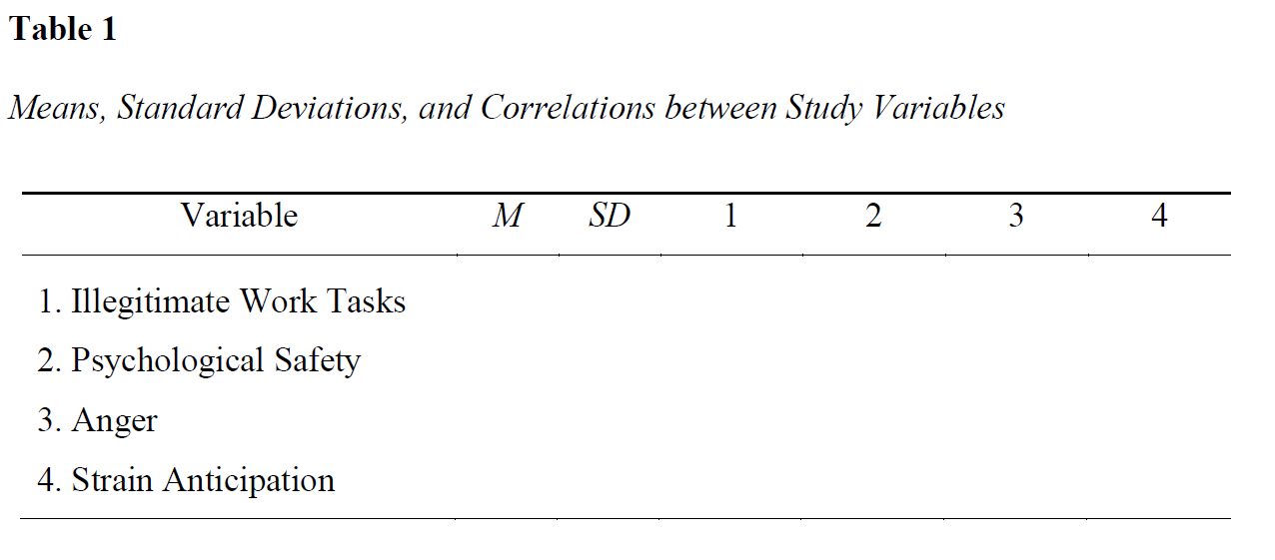
Describing the Study Variables
Introduction
Getting Started
Data Wrangeling
Descriptive Statistics
Inference Statistics
Resources & Best Practices
To summarize descriptive information about our study variables, we have to complete a table like this:
Notes:
R Markdowns consist of three parts "Code" "Report" and "Yaml" to compile.

Slide 58
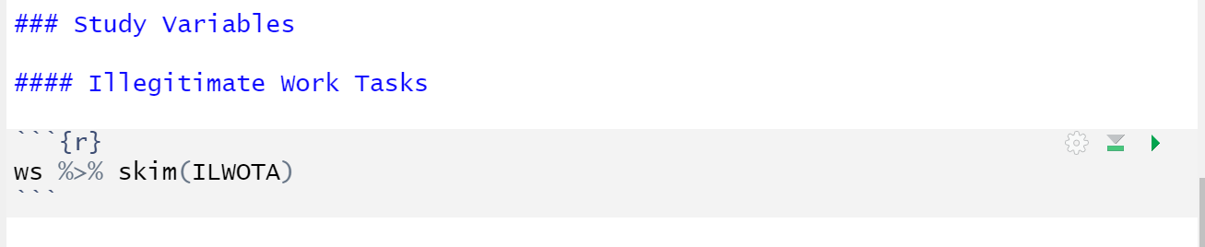
Describing the Study Variables
Introduction
Getting Started
Data Wrangeling
Descriptive Statistics
Inference Statistics
Resources & Best Practices
We already know how to examine means and standard deviations via skim():
Compute the Mean and SD for all study variables and document in in the Descriptive Statistics Table.
Notes:
R Markdowns consist of three parts "Code" "Report" and "Yaml" to compile.

Slide 59
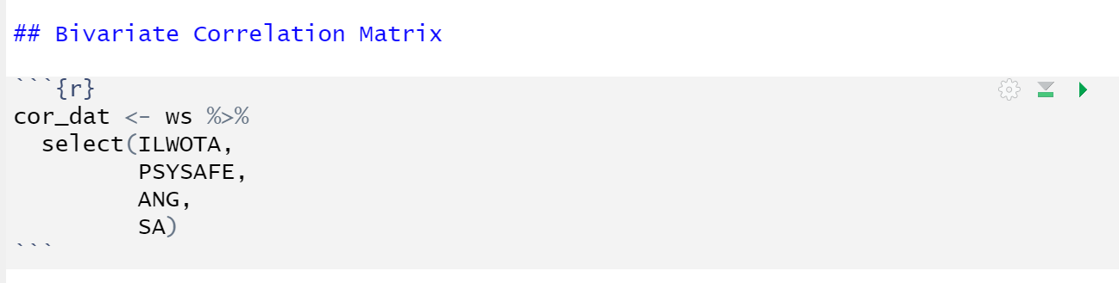
Describing the Study Variables
Introduction
Getting Started
Data Wrangeling
Descriptive Statistics
Inference Statistics
Resources & Best Practices
To compute bivariate correlations, we first have to create a new object that consists only of variables that we wish to include:
name-shortened-dataset-cor <- internal-name-for-dataset %>%
select(variable-of-interest1, variable-of-interest-2)
Notes:
R Markdowns consist of three parts "Code" "Report" and "Yaml" to compile.

Slide 60
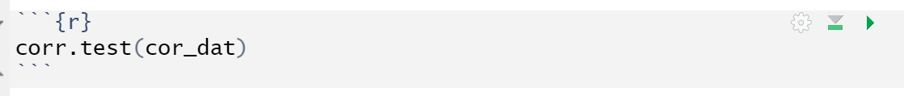
Describing the Study Variables
Introduction
Getting Started
Data Wrangeling
Descriptive Statistics
Inference Statistics
Resources & Best Practices
To compute bivariate correlations, we can now use corr.test():
corr.test(name-shortened-dataset-cor)
Notes:
R Markdowns consist of three parts "Code" "Report" and "Yaml" to compile.

Slide 61
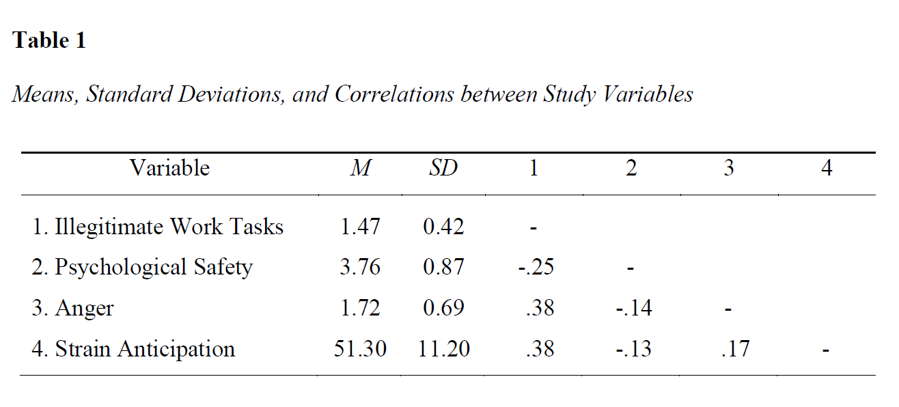
Describing the Study Variables
Introduction
Getting Started
Data Wrangeling
Descriptive Statistics
Inference Statistics
Resources & Best Practices
Now, we can complete the table summarizing the descriptive statistics:
Notes:
R Markdowns consist of three parts "Code" "Report" and "Yaml" to compile.

Slide 62
Hypthesis to statistical model (I)
Introduction
Getting Started
Data Wrangeling
Descriptive Statistics
Inference Statistics
Resources & Best Practices
We can address our hypotheses through the regression framework:
H1: Employees who experience more illegitimate work tasks experience more strain anticipation.
→ Simple linear regression analysis
Notes:
R Markdowns consist of three parts "Code" "Report" and "Yaml" to compile.

Slide 63
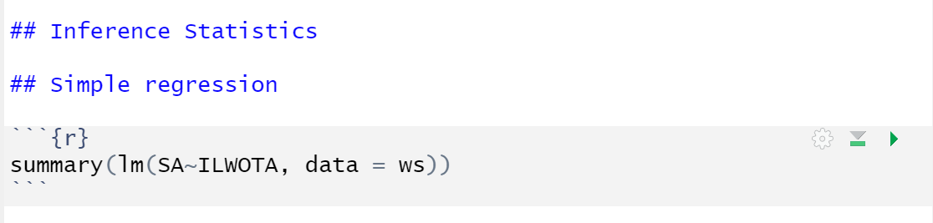
Simple linear regression analysis
Introduction
Getting Started
Data Wrangeling
Descriptive Statistics
Inference Statistics
Resources & Best Practices
To conduct a simple linear regression analyis, we can use lm():
summary(lm(outcome~predictor, data = internal-name-for-dataset)
Notes:
R Markdowns consist of three parts "Code" "Report" and "Yaml" to compile.

Slide 64
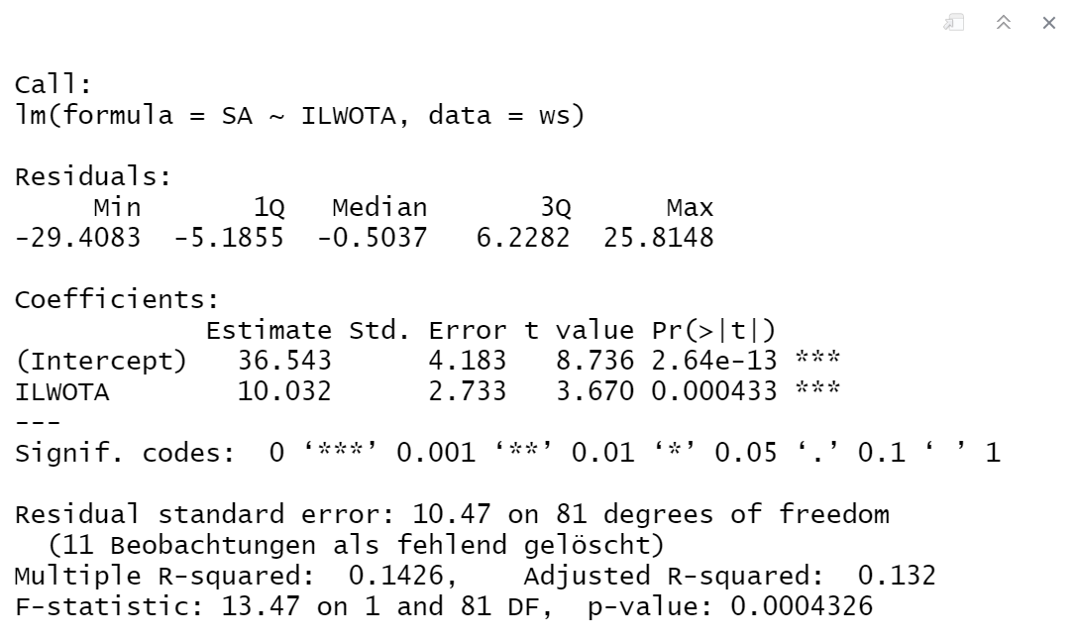
Simple linear regression analysis
Introduction
Getting Started
Data Wrangeling
Descriptive Statistics
Inference Statistics
Resources & Best Practices
How we interpret the output:
There was a positive direct effect of illegitimate work tasks on strain anticipation (b=10.03, SE = 2.73, p < .001).
Notes:
R Markdowns consist of three parts "Code" "Report" and "Yaml" to compile.

Slide 65
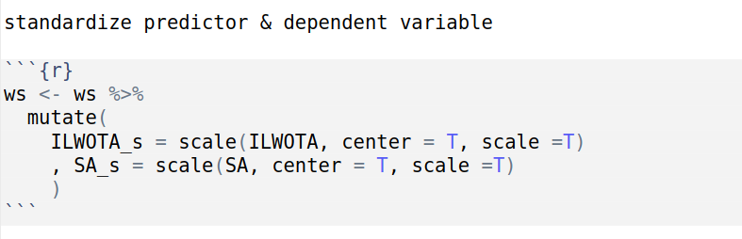
Simple linear regression analysis
Introduction
Getting Started
Data Wrangeling
Descriptive Statistics
Inference Statistics
Resources & Best Practices
If we want to obtain standardized regression coefficients, we first have to standardize the predictor via scale ():
internal-name-for-dataset <- internal-name-for-dataset %>% mutate(
predictor_c = scale(predictor, center = T, scale = T)
, outcome_c = scale(outcome, center = T, scale = T)
)
If we standardize study variables, we substract the mean and deviate by the standard deviation and therefore change their scaling.
Notes:
R Markdowns consist of three parts "Code" "Report" and "Yaml" to compile.

Slide 66
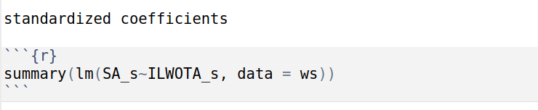
Simple linear regression analysis
Introduction
Getting Started
Data Wrangeling
Descriptive Statistics
Inference Statistics
Resources & Best Practices
We can now obtain standardized regression coefficients by entering our standardized predictor into lm() :
summary(lm(outcome_s~predictor_s, data = internal-name-dataset))
Notes:
R Markdowns consist of three parts "Code" "Report" and "Yaml" to compile.

Slide 67
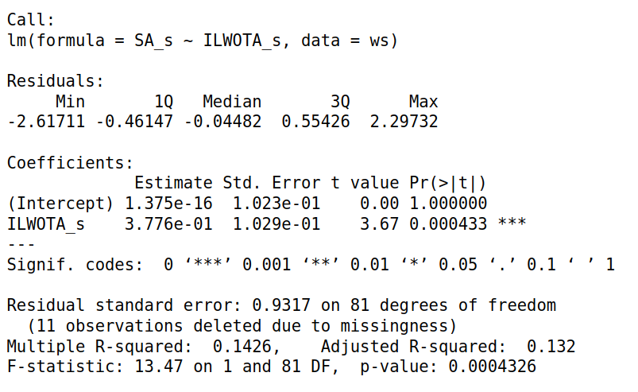
Simple linear regression analysis
Introduction
Getting Started
Data Wrangeling
Descriptive Statistics
Inference Statistics
Resources & Best Practices
Standardization changes the interpretation of our effects but not significance levels:
Standardizing regression coefficients allows one to compare the importance of multiple predictors (multiple linear regression).
(I) Non-standardized regression coefficients
(II) Standardized regression coefficients
When illegitimate work tasks increase by one unit, strain anticipation increases by 10.03 units on average.
When illegitimate work tasks increase by one standard deviation, strain anticipation increases by 0.38 standard deviations on average.
Notes:
R Markdowns consist of three parts "Code" "Report" and "Yaml" to compile.

Slide 68
Hypothesis to statistical model
Introduction
Getting Started
Data Wrangeling
Descriptive Statistics
Inference Statistics
Resources & Best Practices
H2: The effect of illegitimate work task on strain anticipation is partially mediated by anger.
Mediation analysis via successive multiple linear regression analyis
Can be accomplished manually using lm() or via helper function from the 'psych' package.
Notes:
R Markdowns consist of three parts "Code" "Report" and "Yaml" to compile.

Slide 69
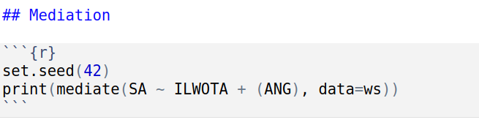
Mediation Analysis
Introduction
Getting Started
Data Wrangeling
Descriptive Statistics
Inference Statistics
Resources & Best Practices
To conduct mediation analysis (in one step), we can use mediate():
print(mediate(outcome ~ predictor + (mediator), data = internal-name-for-dataset))
Note: mediate() uses bootstrapping (random) – due to set.seed() the result is still always the same.
Notes:
R Markdowns consist of three parts "Code" "Report" and "Yaml" to compile.

Slide 70
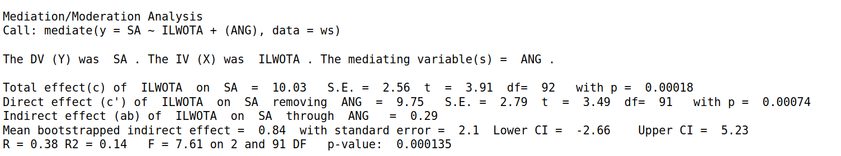
Mediation Analysis
Introduction
Getting Started
Data Wrangeling
Descriptive Statistics
Inference Statistics
Resources & Best Practices
How we interpret the output:
We did not find evidence for an indirect effect of illegitimate work tasks on strain anticipation via anger (point estimate a*b = 0.84, 95% CI = [-2.66; 5.23] ).
Notes:
R Markdowns consist of three parts "Code" "Report" and "Yaml" to compile.

Slide 71
Hypothesis to statistical model
Introduction
Getting Started
Data Wrangeling
Descriptive Statistics
Inference Statistics
Resources & Best Practices
H3: The effect of illegitimate work task on strain anticipation is attenuated by psychological safety.
Moderation analysis via multiple linear regression analyis
Notes:
R Markdowns consist of three parts "Code" "Report" and "Yaml" to compile.

Slide 72
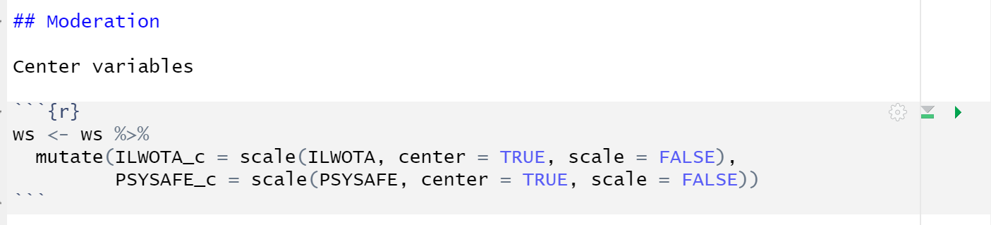
Moderation analysis
Introduction
Getting Started
Data Wrangeling
Descriptive Statistics
Inference Statistics
Resources & Best Practices
We first have to center predictor and moderator via scale ():
internal-name-for-dataset <- internal-name-for-dataset %>%
mutate(predictor_c = scale(predictor, center = T, scale = F),
moderator_c = scale(moderator, center = T, scale = F))
Centering predictors and continuous moderators (aka substracting the mean) is mandatory to ensure meaningful interpretation of the direct effects.
Standardizing is voluntary.
Notes:
R Markdowns consist of three parts "Code" "Report" and "Yaml" to compile.

Slide 73
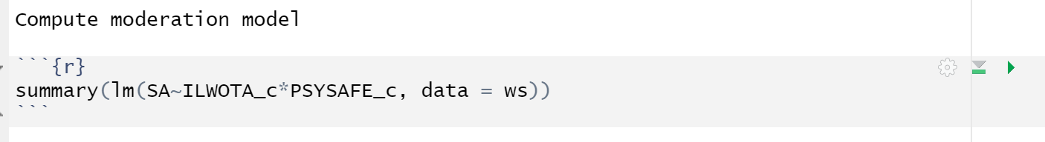
Moderation analysis
Introduction
Getting Started
Data Wrangeling
Descriptive Statistics
Inference Statistics
Resources & Best Practices
To conduct moderation analysis, we can now use lm ():
summary(lm(outcome~predictor_c*moderator_c, data = internal-name-for-dataset)
Notes:
R Markdowns consist of three parts "Code" "Report" and "Yaml" to compile.

Slide 74
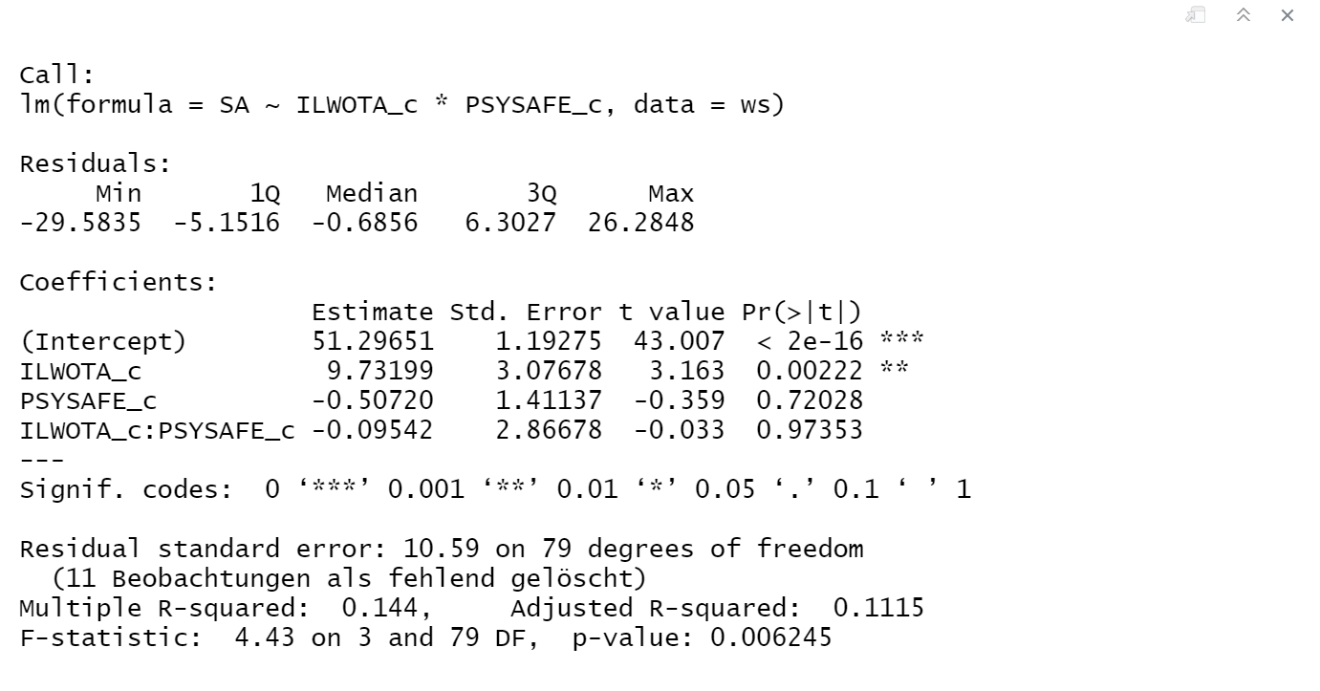
Moderation analysis
Introduction
Getting Started
Data Wrangeling
Descriptive Statistics
Inference Statistics
Resources & Best Practices
How we interpret the output:
The data did not support a moderation effect of psychological safety on the relationship between illegitimate work tasks and strain anticipation (b = -0.10, SE = 2.87, p > .05).
Notes:
R Markdowns consist of three parts "Code" "Report" and "Yaml" to compile.

Slide 75

Moderation analysis
Introduction
Getting Started
Data Wrangeling
Descriptive Statistics
Inference Statistics
Resources & Best Practices
To visualize the moderation effect, we can use interact_plot():
interact_plot(
lm(outcome~predictor_c*moderator_c, data = internal-name-for- dataset),
pred = predictor_c,
modx = moderator_c,
interval = T)
Notes:
R Markdowns consist of three parts "Code" "Report" and "Yaml" to compile.

Slide 76

Moderation analysis
Introduction
Getting Started
Data Wrangeling
Descriptive Statistics
Inference Statistics
Resources & Best Practices
Sidenote: We visualized the effect for demonstartion purposes. If you have a non significant moderation effect it is likely not necessary to visualize it.
Notes:
R Markdowns consist of three parts "Code" "Report" and "Yaml" to compile.

Slide 77

Moderation analysis
Introduction
Getting Started
Data Wrangeling
Descriptive Statistics
Inference Statistics
Resources & Best Practices
Moderation can also be understood as a conditional effect. Evaluate with Johnson-Neyman intervals:
johnson_newman(
lm(outcome~predictor_c*moderator_c, data = internal-name-for- dataset),
pred = predictor_c,
modx = moderator_c,
control.fdr = T)
Notes:
R Markdowns consist of three parts "Code" "Report" and "Yaml" to compile.

Slide 78


Moderation analysis
Introduction
Getting Started
Data Wrangeling
Descriptive Statistics
Inference Statistics
Resources & Best Practices
In our case the slope of ILWOTA is not conditional on PYSAFE.
But it could also look like this example:
Notes:
R Markdowns consist of three parts "Code" "Report" and "Yaml" to compile.

Slide 79

Resources
Introduction
Getting Started
Data Wrangeling
Descriptive Statistics
Inference Statistics
Resources & Best Practices
Document your environment
Notes:
R Markdowns consist of three parts "Code" "Report" and "Yaml" to compile.

Slide 80

Resources
Introduction
Getting Started
Data Wrangeling
Descriptive Statistics
Inference Statistics
Resources & Best Practices
Functions and other concerns:
check documentation of function / package
ask the community (e.g. via stackoverflow)
Programming in R:
https://r4ds.had.co.nz/
Notes:
R Markdowns consist of three parts "Code" "Report" and "Yaml" to compile.

Slide 81
Best Practices
Introduction
Getting Started
Data Wrangeling
Descriptive Statistics
Inference Statistics
Resources & Best Practices
Reproducibility:
use Rprojects, not setwd()
use RMarkdown
never load packages or install datasets through the graphical user interface without documenting executed functions in script
object changes → new object name (we didn’t do that)
use seeds for random parts (e.g. bootstrapping)
document your environment (be a Pro: use Docker for full reproducability)
Notes:
R Markdowns consist of three parts "Code" "Report" and "Yaml" to compile.

Slide 82
Best Practices
Introduction
Getting Started
Data Wrangeling
Descriptive Statistics
Inference Statistics
Resources & Best Practices
Readability:
RMarkdown → use headings sub-headings to clarify structure
structure: packages, data, tidying, analyses
only keep code that is necessary and works to ensure specificity
comment throughout
Notes:
R Markdowns consist of three parts "Code" "Report" and "Yaml" to compile.

Slide 83
References
Introduction
Getting started
Data Wrangeling
Descriptive Statistics
Inference Statistics
Resources & Best Practices
Cranford, J. A., Shrout, P. E., Iida, M., Rafaeli, E., Yip, T., & Bolger, N. (2006). A procedure for evaluating sensitivity to within-person change: Can mood measures in diary studies detect change reliably?. Personality and Social Psychology Bulletin, 32(7), 917-929.
Scott, S.B., Graham-Engeland, J.E., Engeland, C.G. et al. (2015). The Effects of Stress on Cognitive Aging, Physiology and Emotion (ESCAPE) Project. BMC Psychiatry 15(146). doi: 10.1186/s12888-015-0497-7
Semmer, N. K., Tschan, F., Meier, L. L., Facchin, S., & Jacobshagen, N. (2010). Illegitimate tasks and counterproductive work behavior. Applied Psychology: An International Review, 59(1), 70– 96. doi:10.1111/j.1464-0597.2009.00416.x

